Slide 1
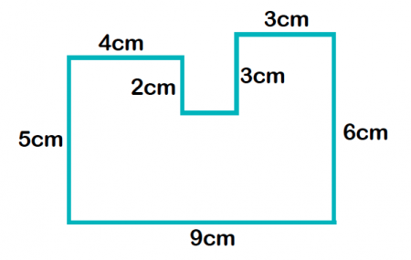
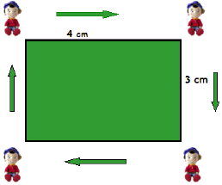
My Measurement Interactive Notebook
Name
Class: 8-
Teacher: Mr Evans
Term 1 Semester 1

Slide 2
24
7
30
Area
Date
EQ – How we can use formulas to find areas of different shapes?

Slide 3
Quickwrite
On the LHS of your INB, spend the next 3 minutes writing everything you know about area.
What is it?
How is it different from perimeter?
Give an example of area
Etc...

Slide 4
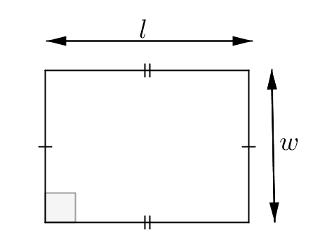
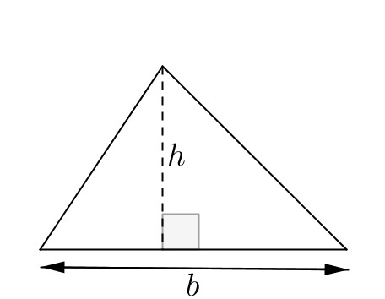
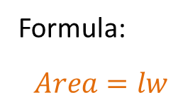
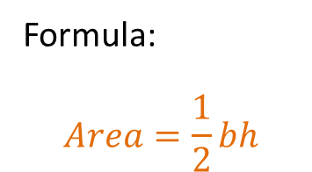
24
7
30
Area
Date
EQ – How we can use formulas to find areas of different shapes?
The area of a shape is the amount of space exists inside a 2 dimensional space. The 3 basic shapes are;
Area of a rectangle
Formula:
$$Area=lw$$
Formula:
$$Area=\frac{1}{2}bh$$
Area of a triangle

Slide 5
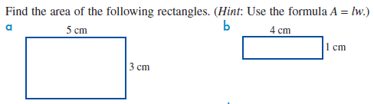
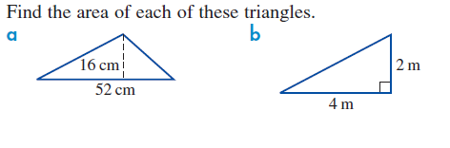
Examples
Let’s try together.

Slide 6
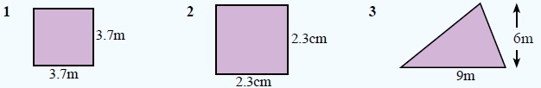

Your turn.

Slide 7
24
7
30
Area
Date
EQ – How we can use formulas to find areas of different shapes?
How do we find the area of more complex shapes like the one below?
7cm
Rectangle
Triangle
20cm
5cm
We break it into it’s composite shapes. What two shapes is the above shape made up of?

Slide 8
24
7
30
Area
Date
EQ – How we can use formulas to find areas of different shapes?
The shape below can be split into 2 pieces, a rectangle and a triangle
+
7cm
7cm
15cm
5cm
To find the area of the whole shape, we find the area of the 2 shapes and add them together.
A=1/2 x base x height
= 0.5 x 7 x 5 cm
= 17.5 cm²
A=length x width
= 7 x 15 cm
= 105cm²
Total area = area of rect. + area of triangle
= 105 + 17.5 = 122.5cm²

Slide 9
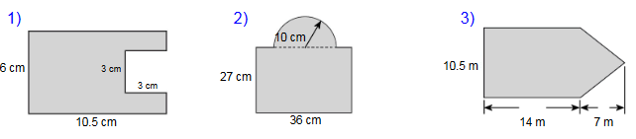
Try these on the LHS of your INB

Slide 11
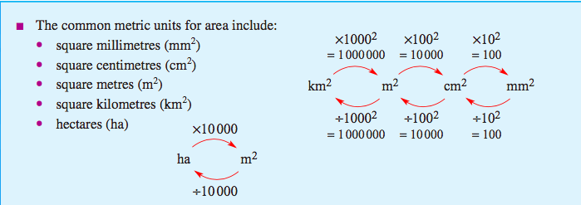
Remember your Conversion Caterpillar!

Slide 12
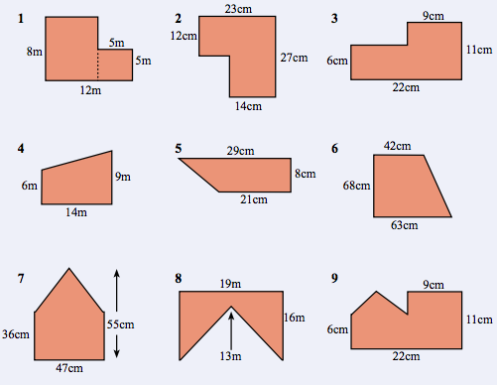
Exercise 17.4 on
page 232 of Dwyer

